Slide 2

x = 2104
y = x
z = 3.1416
p = input(“Caeser said?”)
q = input(“dixerunt Caesaris?”)
Integer 2104
Floating Point 3.1416
String “Veni, Vidi, Vici”
String “Veni, Vidi, Vici”

Slide 3
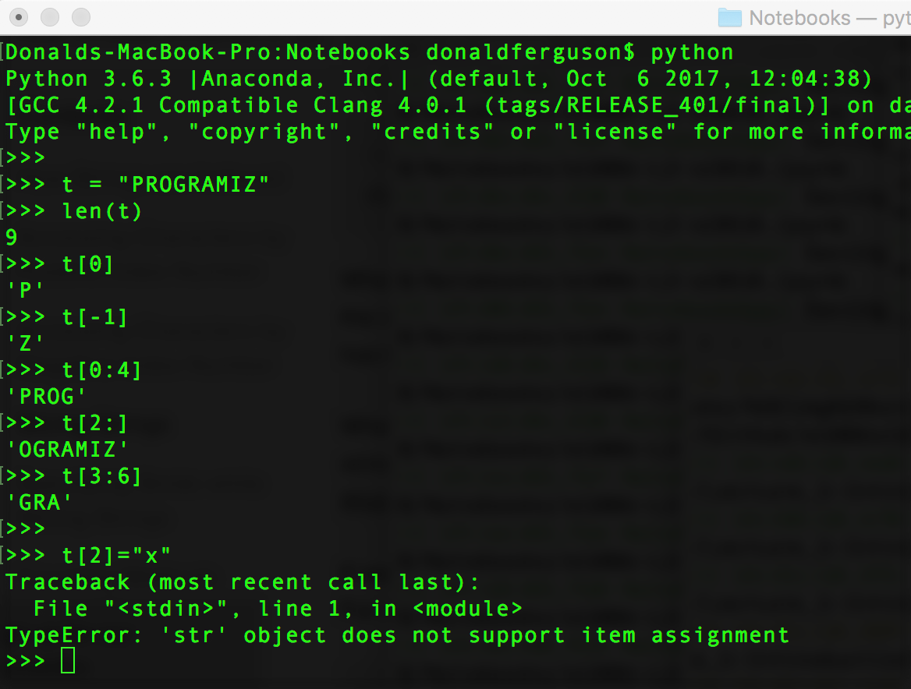
(Text) Sequence Object
This is what “immutable” means.

Slide 4
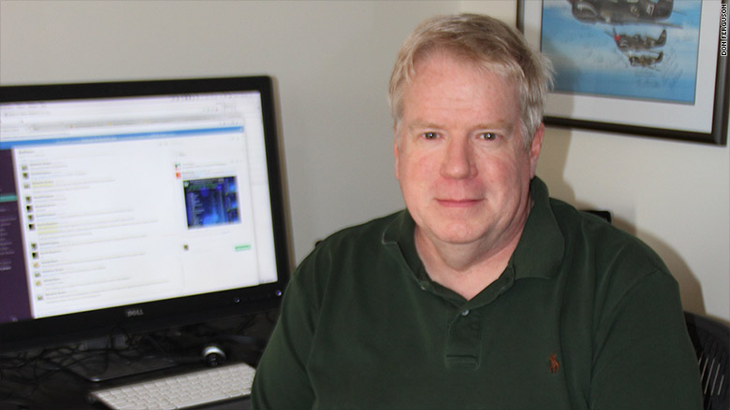
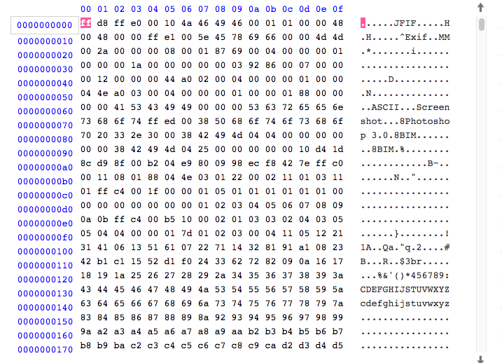
JPEG Image
Underlying File

Slide 5
Web Browser
REST/JSON
HTML, JPG, …
JavaScript
Database Connection
Content Rendering
Web Content Server
Files
Database Server

Slide 6
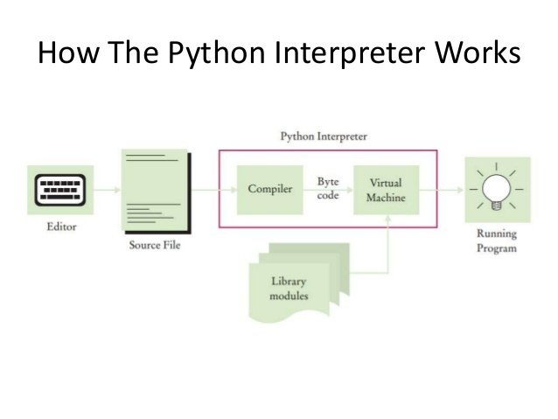

Input data.
Programs that “read”
and process programs like data.
A Python program
someone wrote.

Slide 7
All Python objects ultimately share a small number of fields at the beginning of the object’s representation in memory.
Decimal 1 is hexadecimal x0000000000000001.
In memory, this is 000…..0001, with 63 zeroes.
How does the Python environment know those bytes are an integer and not something else?
Every object in memory has a prefix that is a bunch of bytes/bits. These bytes provide metadata (data about data), including what type of object it is.
Overly simplistically, decimal one is “two 64 bit” pieces of data.
One 64 bit segment encodes the value 1.
One 64 bit segment is a code that indicates INTEGER.

Slide 8
A Turing Machine is a purely theoretical device
Control unit can be in one of a finite number of states (s1, s2, …, sN)
Each tape cell holds one of a finite number of symbols
read/write head overwrites current symbol on each step
read/write head moves one square to the left or right on each step

Slide 9
Python Program
Some input for Python program

Slide 10
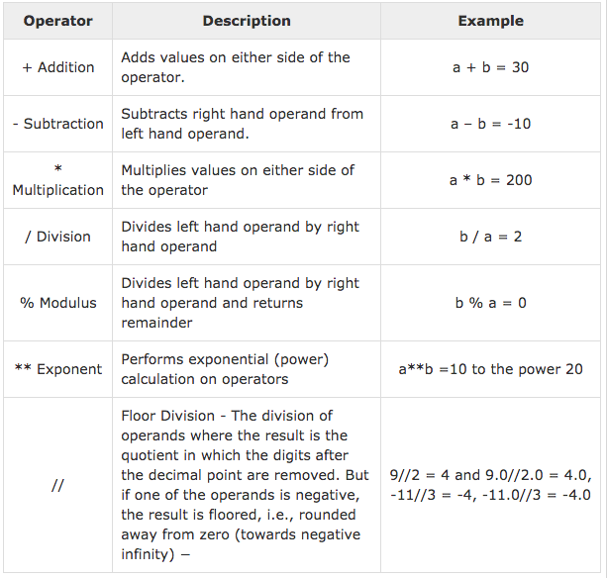
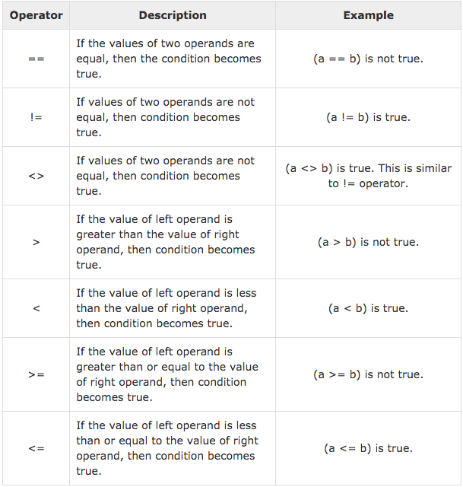
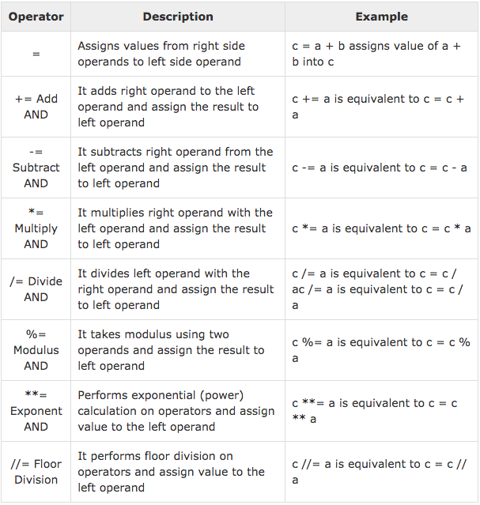

Slide 11
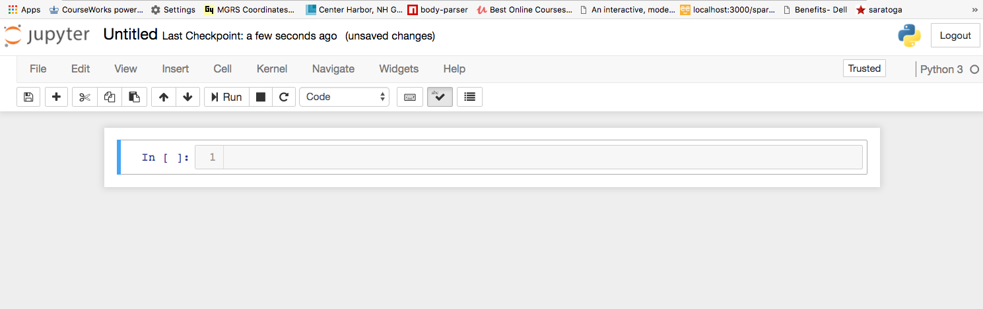
Standard File, Edit, View menus.
A “cell.” We will use two types of cell: 1) Code, 2) Markdown. You can choose the cell type.

Slide 12
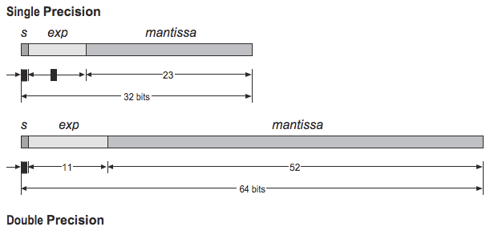
Exponent and mantissa representation.
f = (s) * m * (2 ** e).
m is of the form (+/-) 1.1011010010…101 binary,
Which has an equivalent (logical) representation in decimal, e.g. (+/-) 1.2479321…
Range
e is 11 bits, which is 2048. We need negative. So, the range is -1023 to + 1023.
m is 52 bits. 52 digits binary is approximately 15 digits decimal.

Slide 13
“Run along kid.
You’re bothering me!”

Slide 14
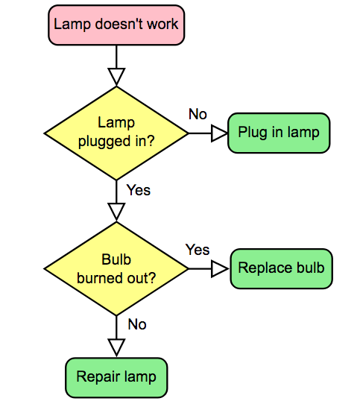
Yell at girlfriend

Slide 15
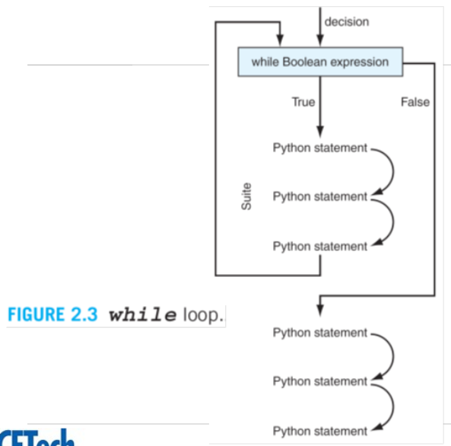

Slide 16
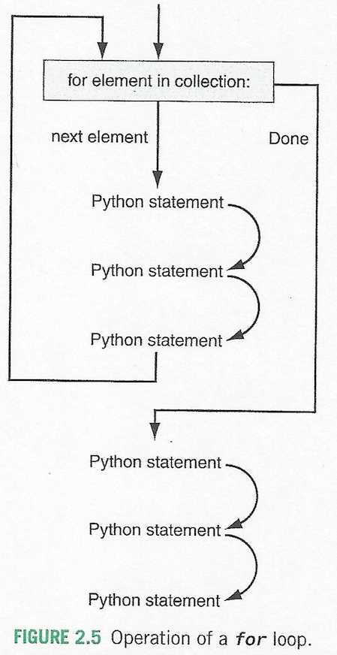

Slide 18
Logon and start remote terminal session.
Send commands
Copy files
etc.

Slide 19
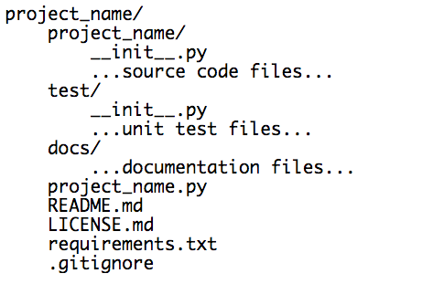
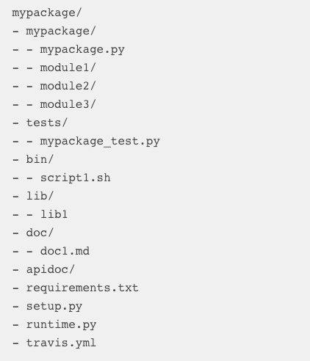
http://www.patricksoftwareblog.com/structure-of-a-python-project/
https://tutorialedge.net/python/python-project-layout/

Slide 20

Don’t be “that guy.”

Slide 21
Memory Access Times
Actual Time
For perspective
If a CPU executed 1 instruction
per second, some other times
would be …

Slide 22
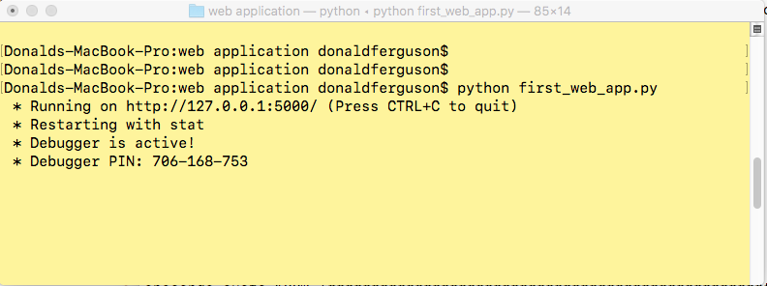
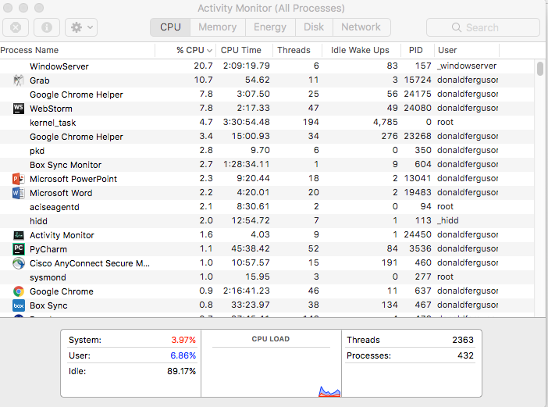
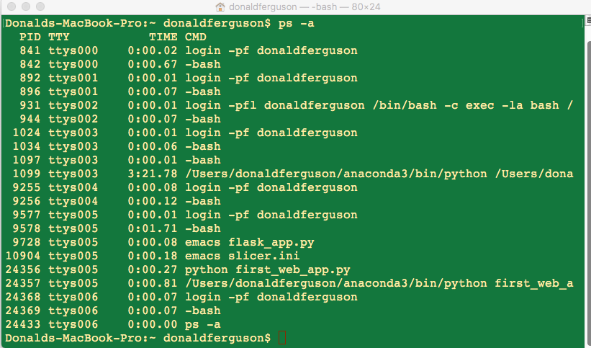
Flask application process
All running processes on system.
All my running processes

Slide 23
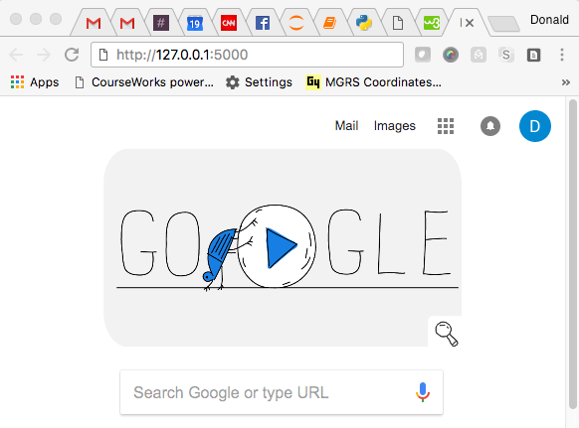
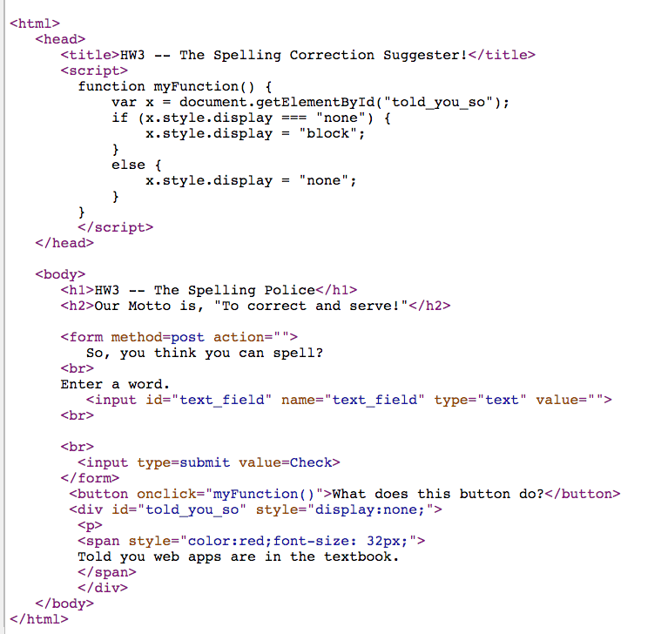
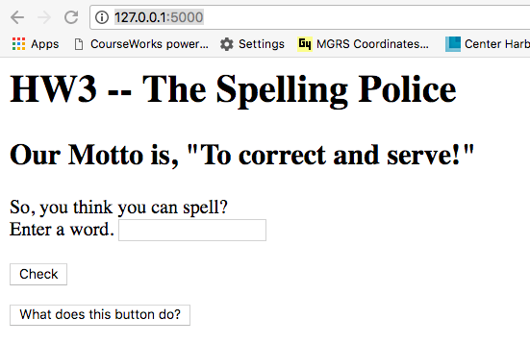
System
P1
P3
…
GET 127.0.0.1:5000
P2
…
Flask
P4
OK 200
content-type: text/html

